Slide 1
KSS Training Date: 16.05.2023 Presenter: Arunava Mitra Topic: Karate Framework (API Automation)

Slide 2
Introduction to Self and Topic
Karate Testing Framework (API)
Introduction to API
Introduction to Karate
What is Karate?
Why Karate?
Installation and Initial setup
Explanation of Folder Structure
API Test Example
Writing and Executing Test cases
Test Reports
Benefits and Cross Utilization
Question

Slide 3
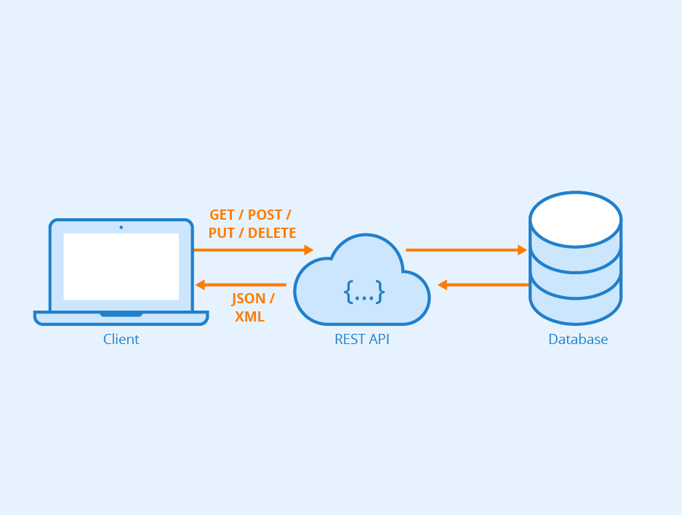
Introduction to API
API is Application Programming Interface. API enables communication and data exchange between two separate software systems.

Slide 4
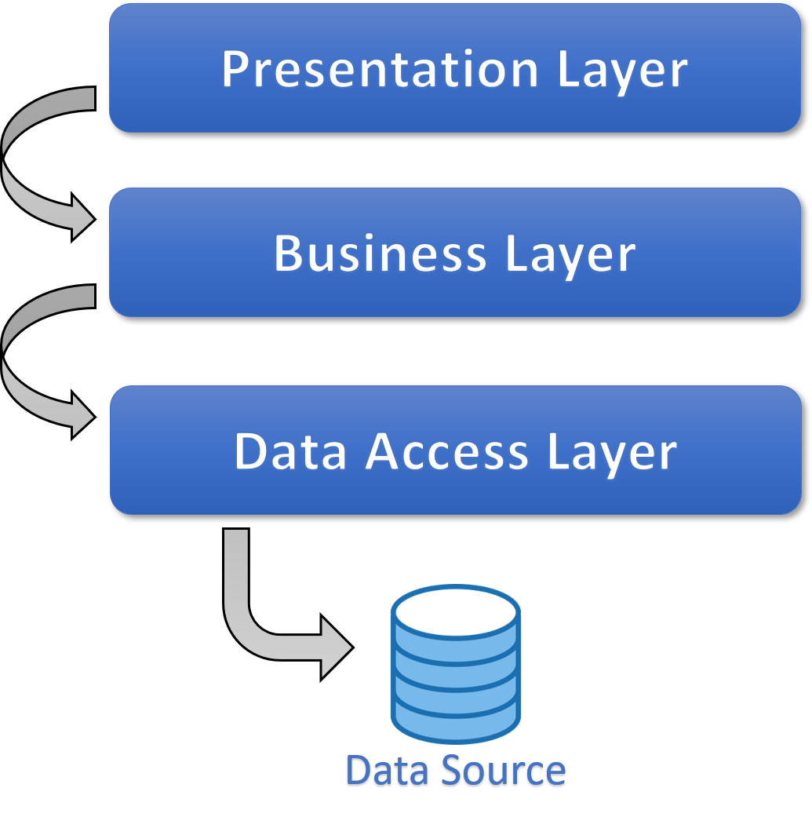
Layers of an Application
Application 1 can be built on any Technology e.g.: SAP
API logics resides here .So, Testing is performed here
Application 2 can be built on any Technology e.g.: Java

Slide 5
What is API Testing?
API Testing is a type of Software testing where the interface in between two applications be on same or different Technology stack is getting tested
It is used to check the functionality, reliability , performance, and security of the programming interfaces.
API Testing does not include GUI (Graphical User Interface).
API testing is performed on message layer (Message that sends the information in the form of XML or JSON from application to application or server)

Slide 6
Introduction to Karate
Karate is an open-source tool to perform API test-automation (SOAP + REST)
Can also do API mocking, performance-testing and even UI automation into a single, unified framework
Use BDD Syntax (Gherkin syntax)
Created By Peter Thomas on 2017

Slide 7
Why Karate ?
Easy for non programmers
Requires no technical programming language
Parallel Testing
Distributed Testing
Multi environment Testing
Data Driven Testing (CSV,JSON,YAML files..)
Debugging
Reporting
Cross browser Web UI Testing
Cross Platform Desktop Testing
Performance Testing using Gatling

Slide 8
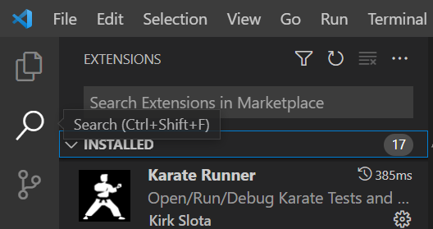
Installation and Initial Setup
System Requirements
JDK 1.8 (java –version)
Maven (mvn –version)
Set environment variable
Karate Runner Extension
Editor :
Visual studio code
Intellij
Eclipse

Slide 9
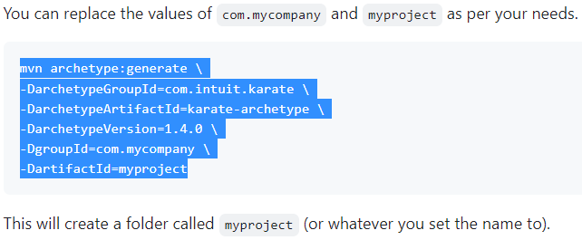
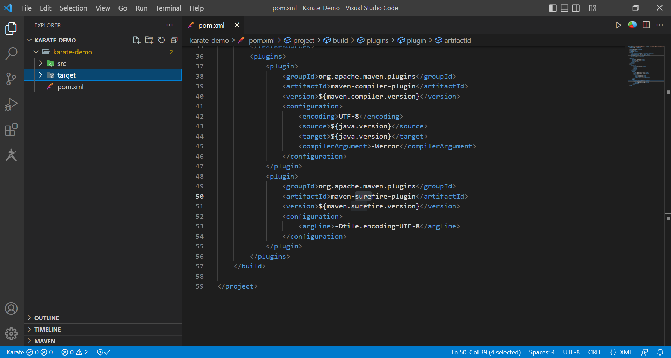
Installation and Initial Setup (continued)
Karate project setup
Open CMD move to specific folder
Run command from ‘https://github.com/karatelabs/karate#quickstart’
Type ‘Code .’ and it will open that project in Visual code
Check pom.xml

Slide 10
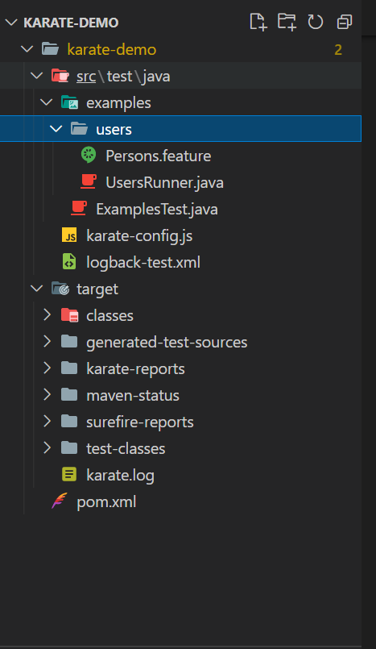
Karate project Structure
Karate project structure consists of the following folders

Slide 11
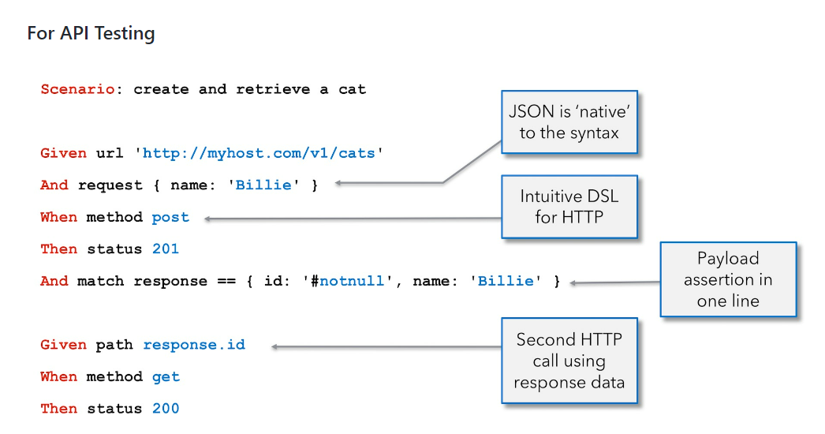
API Test Example

Slide 12
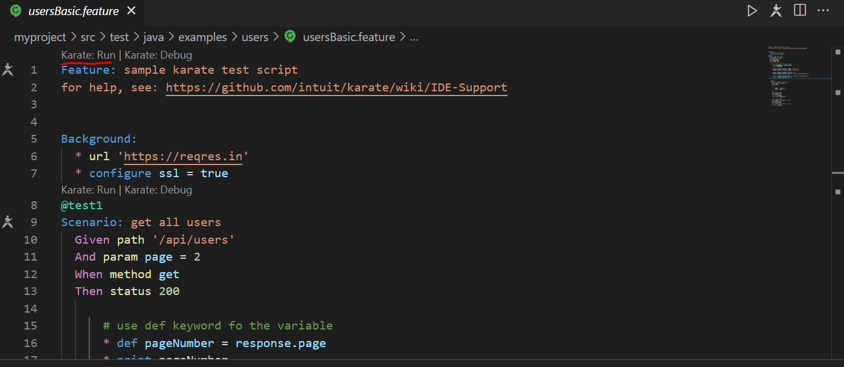
Writing and Executing Test cases using Test Runner Extension

Slide 13
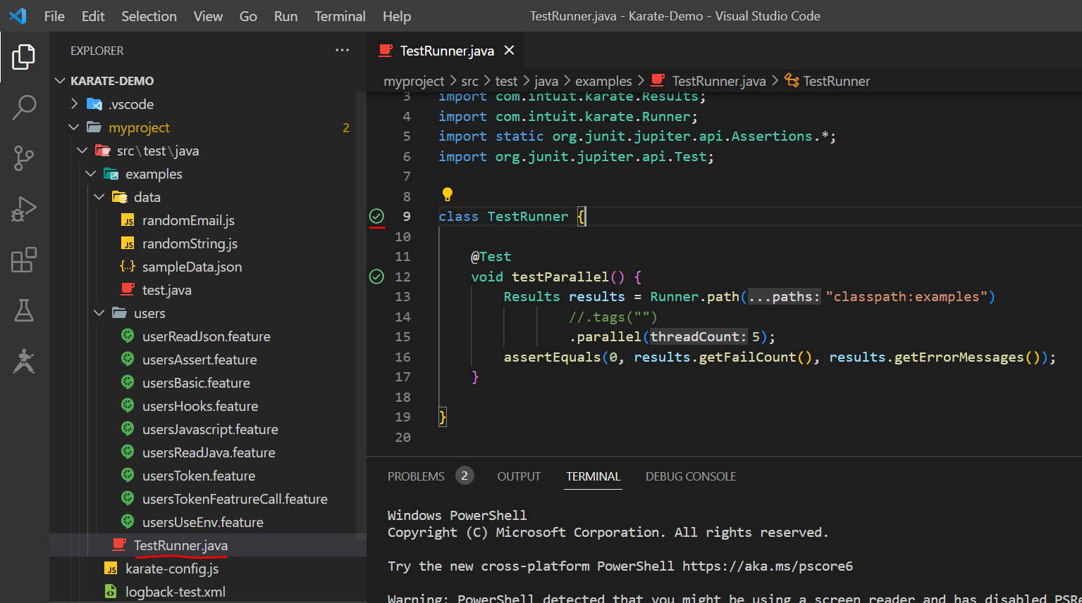
Writing and Executing Test cases using Runner.java

Slide 14
Writing and Executing Test cases using CMD
mvn clean test -D karate.env=qa -D karate.options="--tags @tagname"

Slide 15
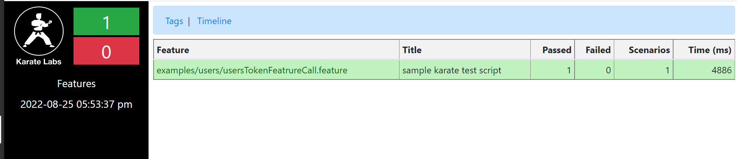
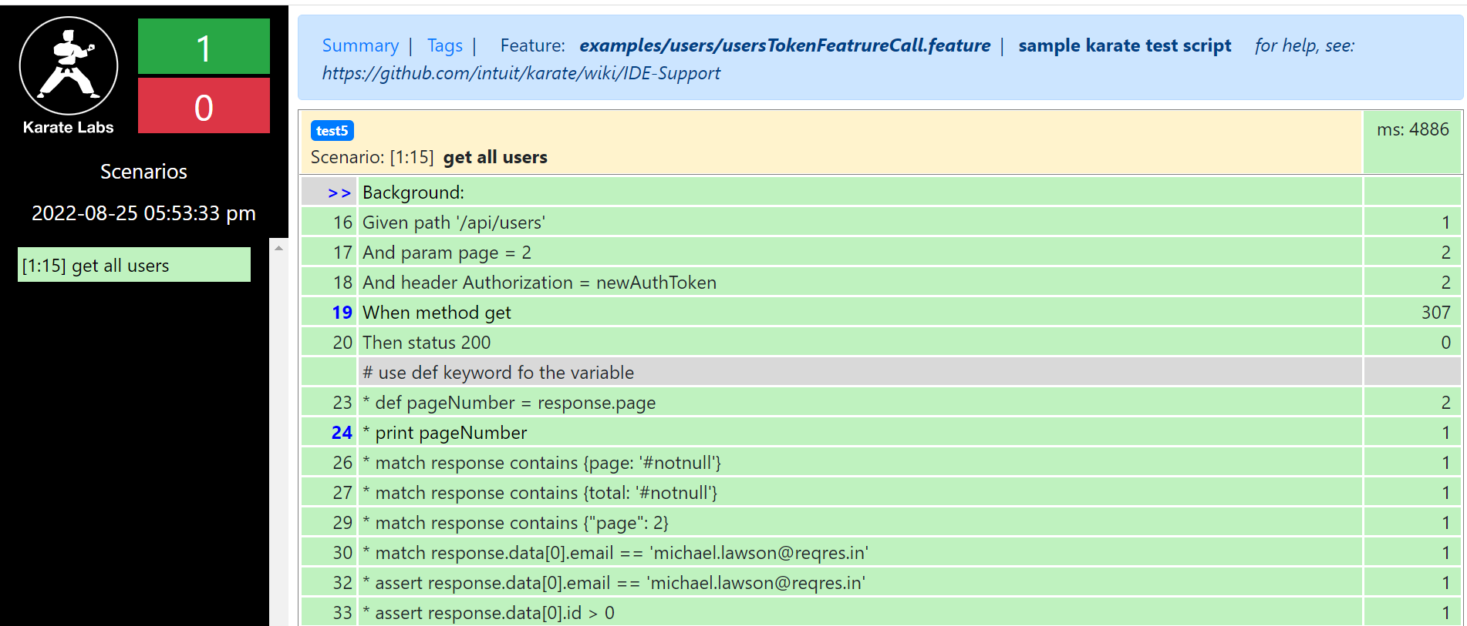
Reports

Slide 16
Benefits and Cross Utilization
1
Easy to start with little coding
2
Native JSON support: We can write JSON expressions right in our feature files
3
It has a very powerful JSON validation
4
In Karate we can write our code in java or JS
5
Karate has multi-thread parallel execution
6
Performance and UI testing can also be done

Slide 17
Question?

